Slide 6
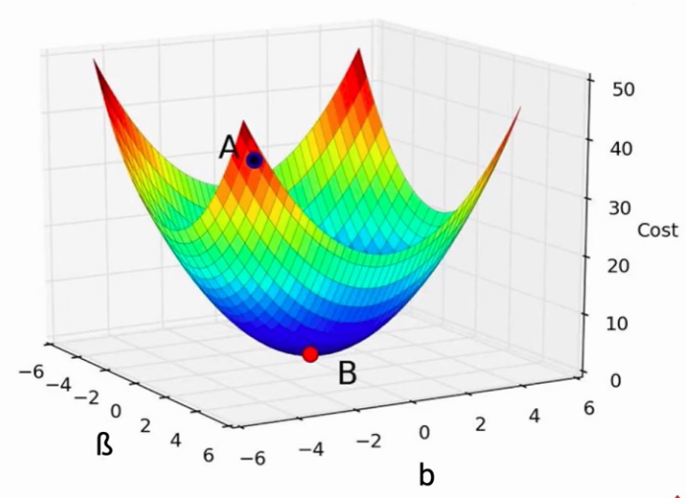
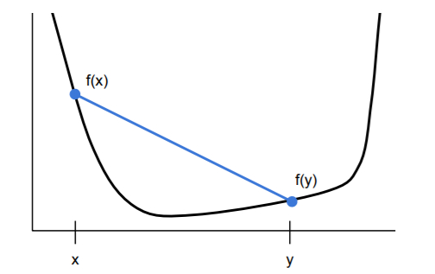

Unconstrained Convex Optimization
$Consider the optimization problem\min_{x}{f(x)}$ , where f : R^{n} → R is convex and smooth,
then the necessary and sufficient condition for optimal solution x₀ is $∇f\left(x\right)=0 at x=x0$.
https://www.cs.utah.edu/~jeffp/IDABook/T6-GD.pdf

Slide 10
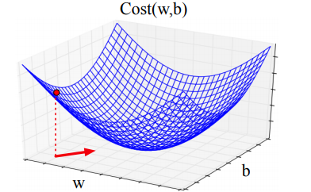
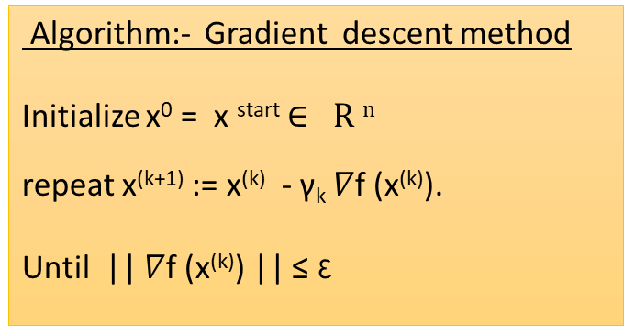
Gradient descent algorithm
An iterative algorithm
The negative gradient direction is the direction of steepest descent.
f(x₁,x₂)
Algorithm:- Gradient descent method
Initialize x⁰ = x ^{start} $∈ R n$
repeat x^{(k+1)} := x^{(k)} - γ_{k} $∇$f (x^{(k)}).
Until || $∇$f (x^{(k)}) || ≤ ε
x₂
x₁
https://www.cs.utah.edu/~jeffp/IDABook/T6-GD.pdf

Slide 17
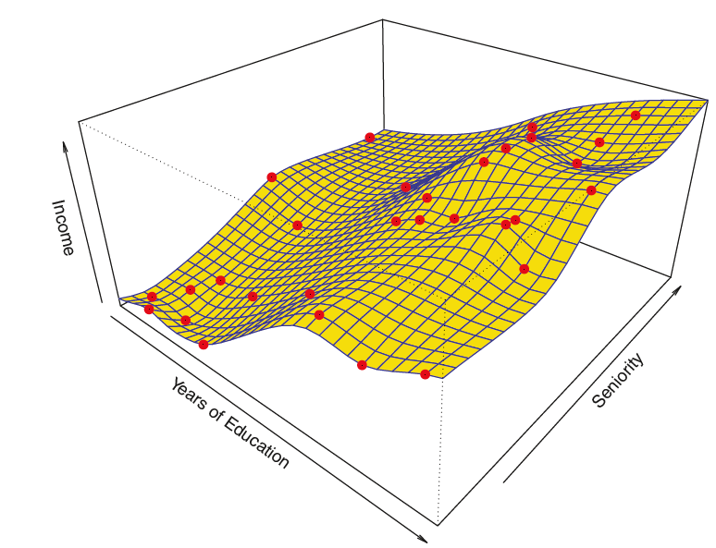
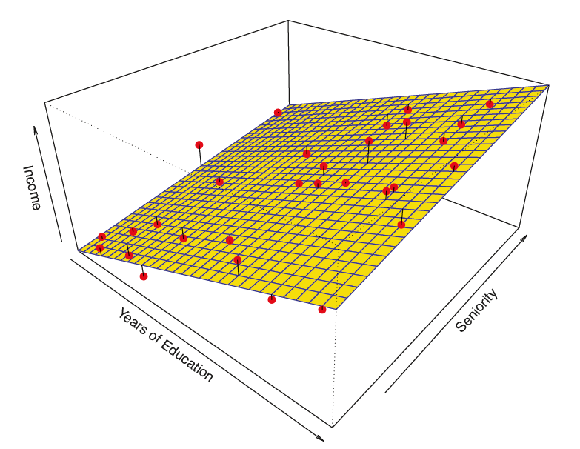

Least squares non-linear regression model
Linear Regression model
Non-linear Regression model

Slide 20



Least squares quadratic regression model
For the sake of simplicity, let us consider X = $\left[\begin{aligned}x1 \\ x2\end{aligned}\right].$
Then the quadratic function of X
f(X) = X^{T}CX + W^{T}X + b = $\left[x1, x2\right]\left[\begin{matrix}w11 & \frac{w12}{2} \\ \frac{w12}{2} & w22\end{matrix}\right] \left[\begin{matrix}x1 \\ x2\end{matrix}\right]$ + $\left[w1, w2\right]\left[\begin{matrix}x1 \\ x2\end{matrix}\right]$ + b = $w11x12+w12x22+w12x1x2+w1x1+w2x2+b$.
then the minimization of Least Square Loss function will let us obtain the problem
Min _{(b,w1,w2,w12,w11,w22)} $\sum_{i=1}^{l}{(Y−(w11xi12+w12xi22+w12xi1xi2+w1xi1+w2xi2+b\text{))}\text{2}\text{. }}$_{..(1)}
If we consider H = $\left[\begin{matrix}x112 & x122 & x12x11 \\ \begin{aligned}− \\ −\end{aligned} & \begin{aligned}− \\ −\end{aligned} & \begin{aligned}− \\ −\end{aligned} \\ xl12 & xl12 & xl2xl1\end{matrix}\begin{matrix} x11 & x12 & \begin{aligned} \\ 1\end{aligned} \\ \begin{aligned}− \\ −\end{aligned} & \begin{aligned}−\end{aligned} & \begin{aligned}− \\ .−\end{aligned} \\ xl1 & xl2 & 1\end{matrix}\right] and \text{u} \text{= }\left\lceil \begin{matrix}\begin{aligned}w11 \\ w22 \\ w12 \\ w1 \\ w2\end{aligned} \\ b\end{matrix}\right\rceil$ then the optimization problem (1) can be obtained as ${\text{Min}}_{(u) } f\left(u\right)=Min(u)\left(Y−Hu\right)T(Y−Hu)$ .
Setting $∇u f\left(u\right) =0 let us obtain$
u =$\left\lceil \begin{matrix}\begin{aligned}w11 \\ w22 \\ w12 \\ w1 \\ w2\end{aligned} \\ b\end{matrix}\right\rceil$= $\left(HTH\right)−1 HTY$

Slide 22
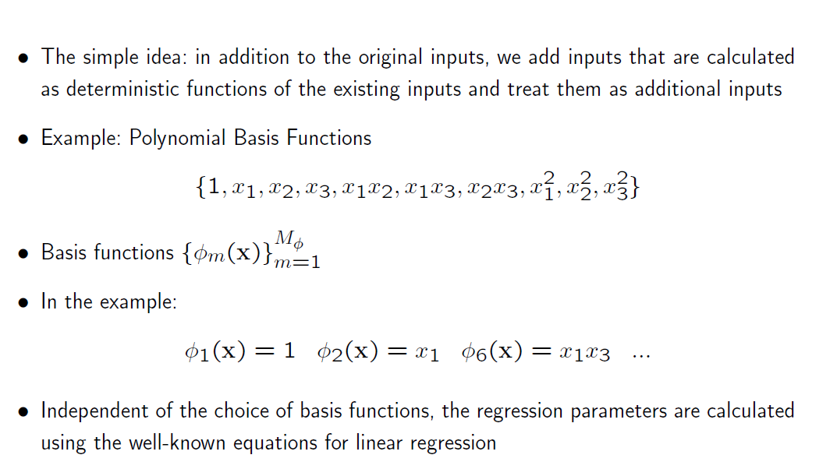

Slide 23
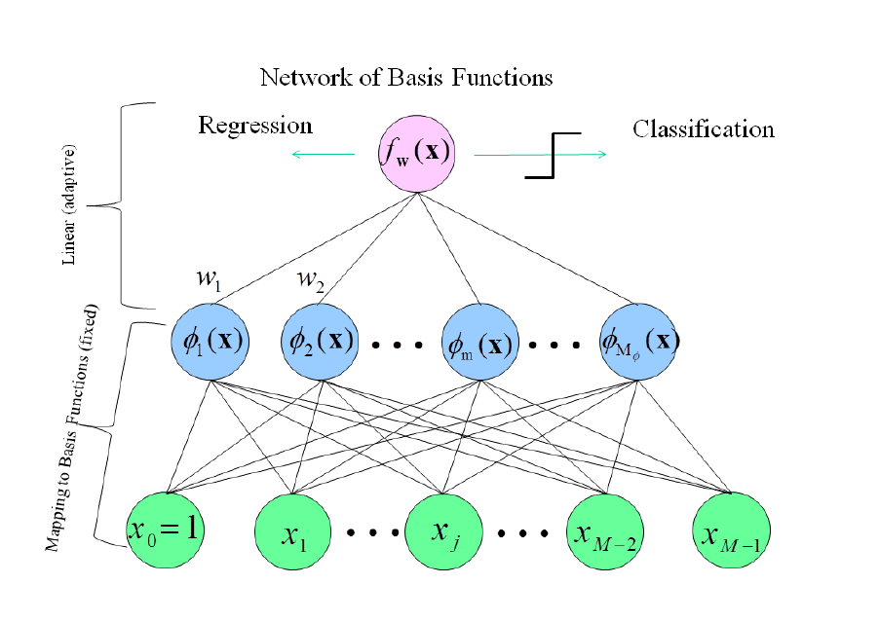

Slide 26
